Slide 1
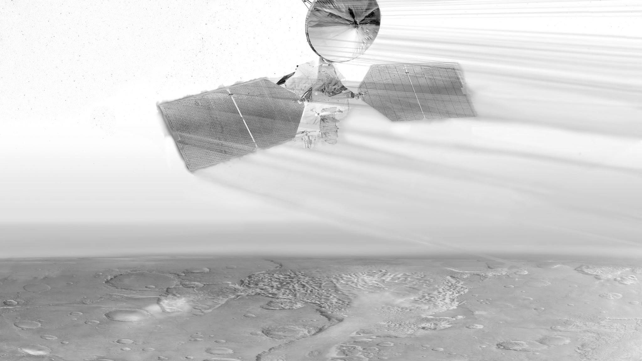

AEROBRAKING AT MARS:
A Machine Learning Implementation
Giusy Falcone
Zachary R. Putnam
Department of Aerospace Engineering
University of Illinois at Urbana-Champaign

Slide 2
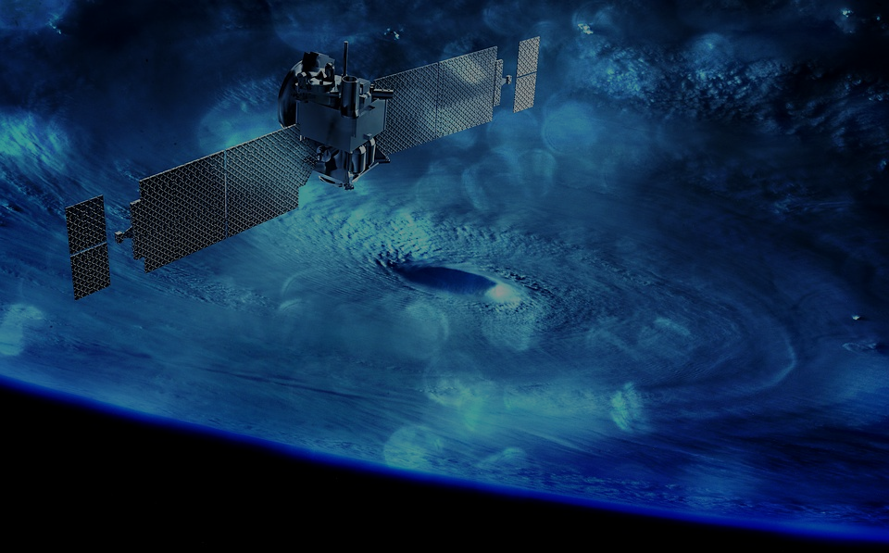
1. THE CONCEPT
Aerobraking, Autonomy, Goal & Challenges

Slide 3
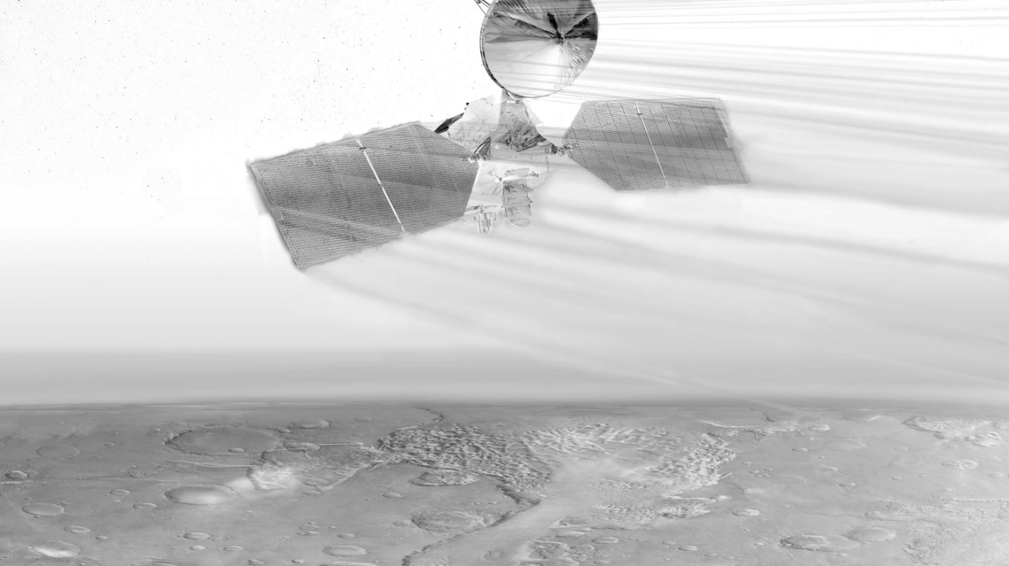
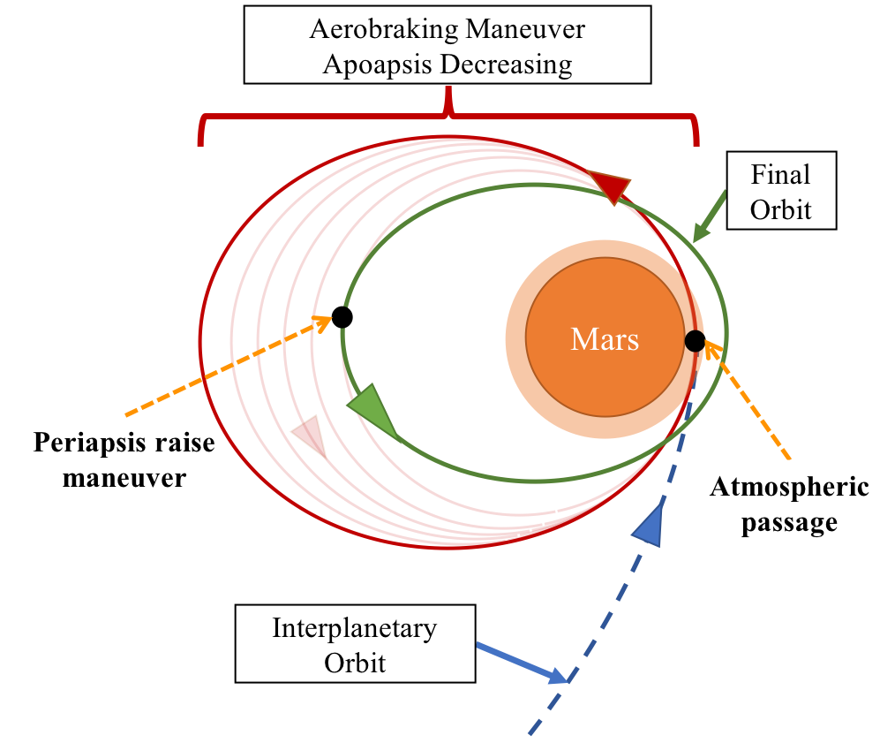
AEROBRAKING
Aerobraking is a maneuver that uses successive passes through the upper atmosphere to dissipate orbital energy.
Creation of drag is a function of velocity and flight-path angle
Propulsive maneuvers at apoapsis control velocity and flight-path angle

Slide 4
IMPORTANCE OF AEROBRAKING & AUTONOMY
Benefits and Costs
Massive propellant saving WRT single propulsive maneuver at the expense of risk caused by variability in atmospheric density (heat rate & dynamic pressure)
Successfully performed for three Mars missions:
Mars Global Surveyor (1996)
Mars Odyssey (2001)
Mars Reconnaissance Orbiter (2005)
Importance of Autonomy
Ground cost, a team of engineers always-online, less aggressive conditions (more when orbital period decreases)
Previous efforts to address these issues with autonomy:
Aerobraking Autonomous Control (1999-2012)

Slide 5
GOAL AND
CHALLENGES
Perform a complete and successful autonomous aerobraking campaign at Mars with a learning and adaptive behavior approach while:
1. Satisfying constraints on dynamic pressure and heat rate
2. Managing mission risk
3. Minimizing control effort and time of flight (cost)

Slide 6
2. PROBLEM FORMULATION
Mission Modeling, Reinforcement Learning and Interface

Slide 7
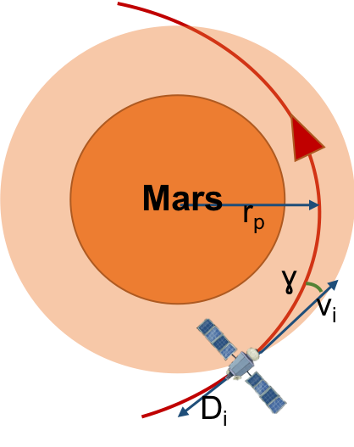
AEROBRAKING MISSION MODELING
Aerobraking mission: vary periapsis altitude to lower apoapsis altitude while satisfying constraints
r_{ao}
r_{pi}
Keplerian Trajectory Simulator
Autonomy
v_{i}, fpa_{i}
Aeroassist Simulation
r_{ai}, dp_{i,} hr_{i}

Slide 8
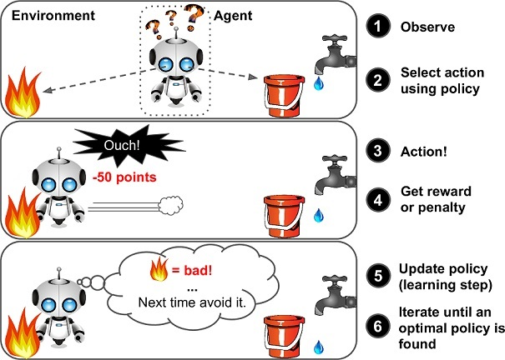
REINFORCEMENT LEARNING
Tabular Q-Learning Algorithm with ε-greedy policy search
<S, A,P ª_{ss’}, R ª_{ss’}, γ >
S = apoapsis radius
A = periapsis altitude
R ª_{ss’} =reward built to minimize the aerobraking whole time.
“
Reinforcement learning is learning what to do…so as to maximize a numerical reward signal. (Sutton)

Slide 9
INTERFACE BETWEEN MISSION AND RL
A trained policy chooses when perform a trim maneuver to minimize the aerobraking time and to avoid the violating constraints.

Slide 10
3. RESULTS
Aerobraking Simulation, Constraints & Corridor, Learning

Slide 11


AEROBRAKING SIMULATION
Apoapsis radius from 200,000 km to 5,000 km
PERIAPSIS

Slide 12
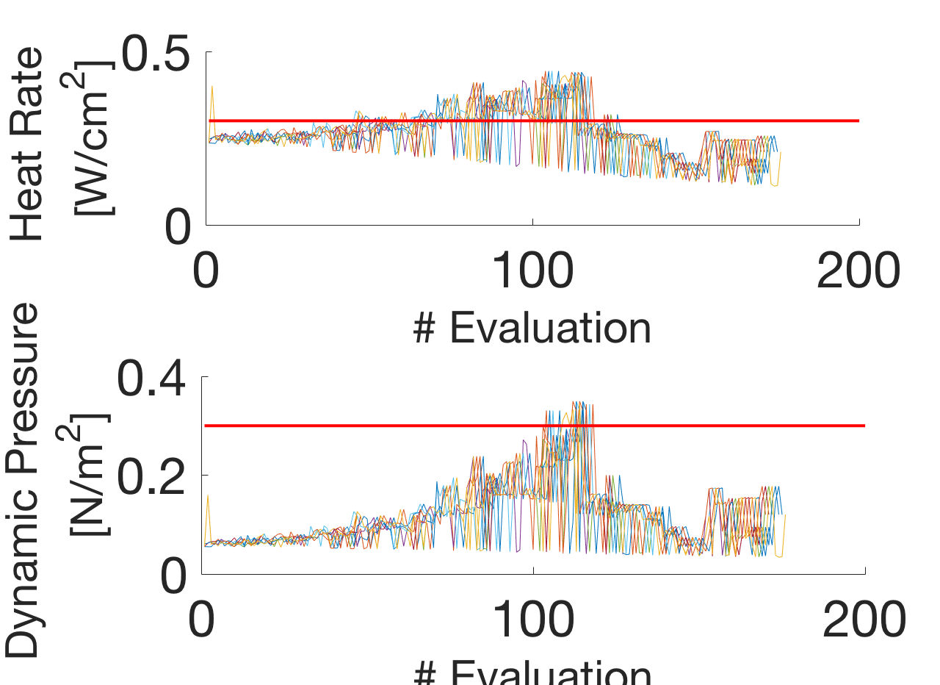
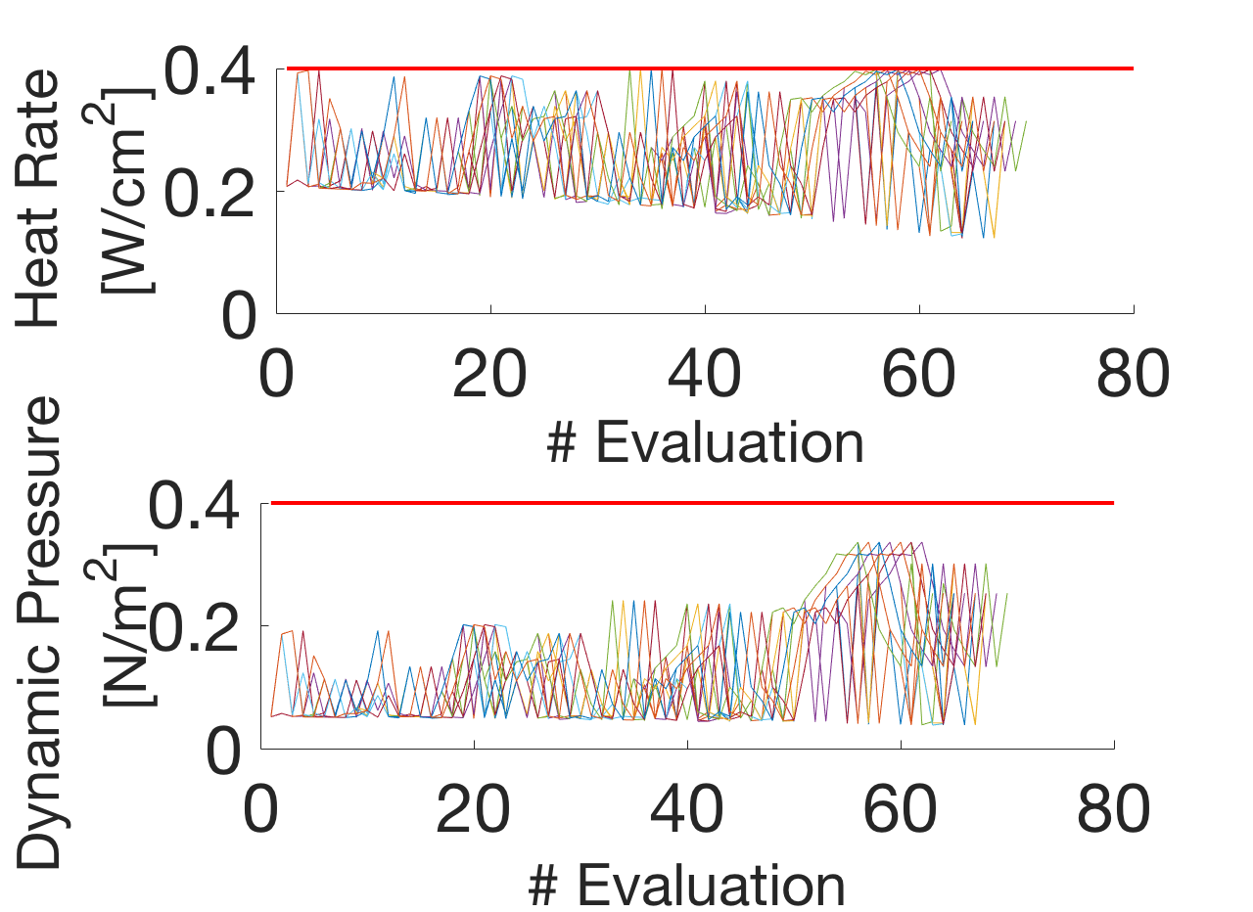
CONSTRAINTS AND CORRIDOR
# Orbit
# Orbit
# Orbit
# Orbit
NOT TRAINED MACHINE
TRAINED MACHINE

Slide 13
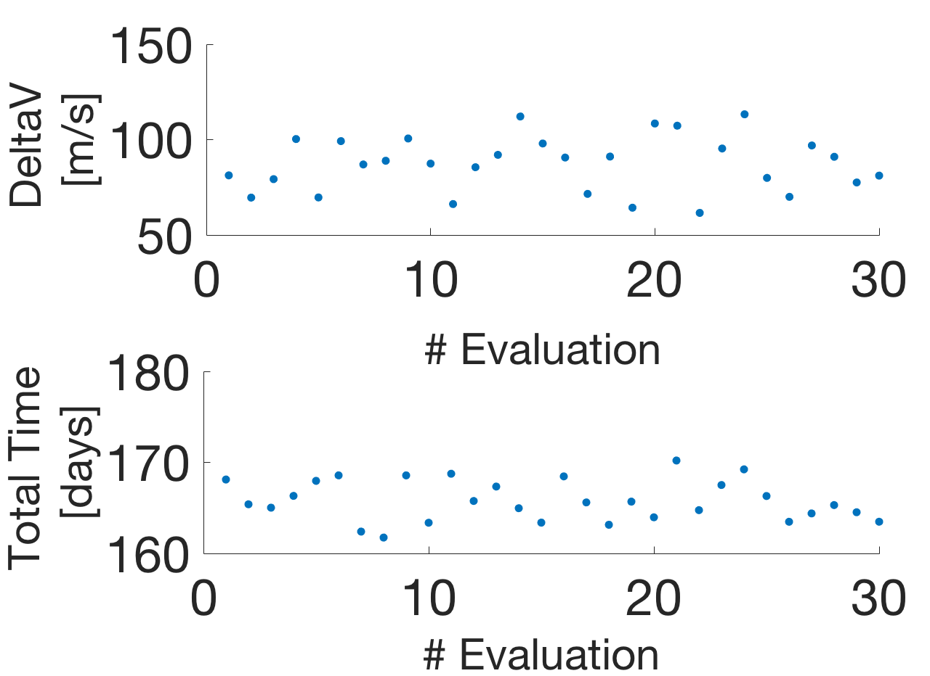
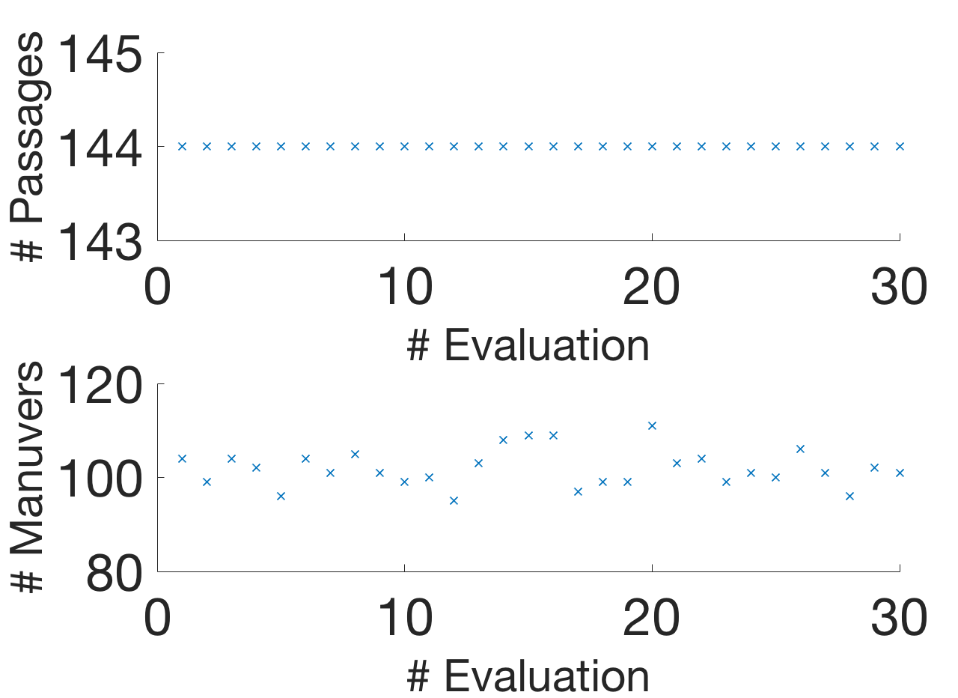
RESULTS DELTA-V AND TOTAL TIME
REWARD FUNCTION DECREASES ONLY TOTAL TIME

Slide 14

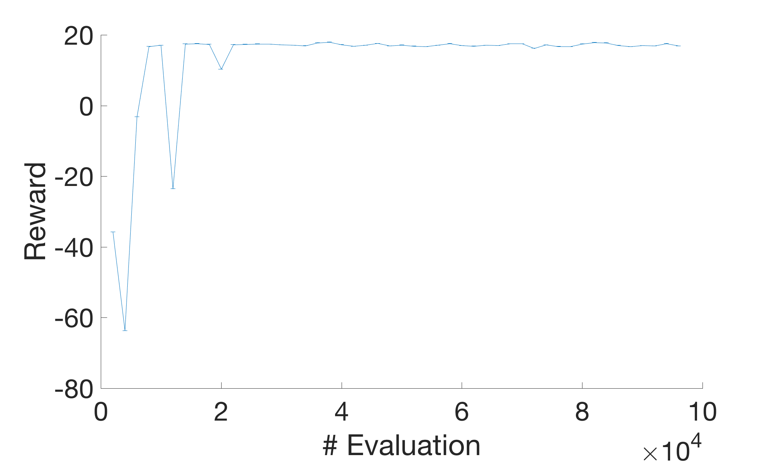
LEARNING PROCESS
Reward:
If reach goal
If heat rate and dynamic pressure closer to corridor boundary (dynamic)
Penalty:
If overcome heat rate (0.4 W/cm²), dynamic pressure (0.4 N/m^2)
If escape/impact
If apoapsis radius does not variate

Slide 15
THANKS!
Any questions?
You can find me at:
gfalcon2@illinois.edu

Slide 16

REFERENCES
J. L. Hanna, R. Tolson, A. D. Cianciolo, and J. Dec, “Autonomous aerobraking at mars,” 2002.
J. L. Prince, R. W. Powell, and D. Murri, “Autonomous aerobraking: A design, development, and feasibility study,” 2011.
J. A. Dec and M. N. Thornblom, “Autonomous aerobraking: Thermal analysis and response surface development,” 2011.
R. Maddock, A. Bowes, R. Powell, J. Prince, and A. Dwyer Cianciolo, “Autonomous aerobraking development software: Phase one performance analysis at mars, venus, and titan,” in AIAA/AAS Astrodynamics Specialist Conference , 2012, p. 5074.
D. G. Murri, R. W. Powell, and J. L. Prince, “Development of autonomous aerobraking (phase 1),”2012.
D. G. Murri, “Development of autonomous aerobraking-phase 2,” 2013.
Z. R. Putnam, “Improved analytical methods for assessment of hypersonic drag-modulation trajectory control,” Ph.D. dissertation, Georgia Institute of Technology, 2015.
A. Geramifard, T. J. Walsh, S. Tellex, G. Chowdhary, N. Roy, J. P. How et al. , “A tutorial on linear function approximators for dynamic programming and reinforcement learning,” Foundations and Trends® in Machine Learning , vol. 6, no. 4, pp. 375–451, 2013.
J. L. H. Prince and S. A. Striepe, “Nasa langley trajectory simulation and analysis capabilities for mars reconnaissance orbiter.”
V. Mnih, "Playing atari with deep reinforcement learning." arXiv preprint arXiv:1312.5602 (2013).
R.S . Sutton, and A. G. Barto. “ Reinforcement learning: An introduction. “, Vol. 1. No. 1. Cambridge: MIT press, 1998.
M. Techlabs, “ Picture Reinforcement Learning Explanation. “, Retrieved from https://goo.gl/images/JTxJpf

Slide 17
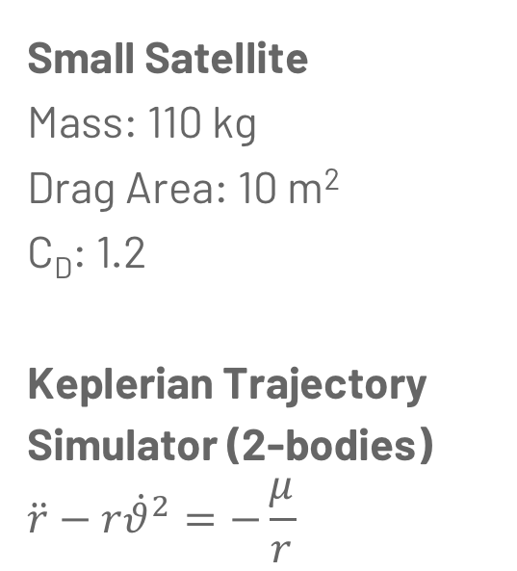
MISSION DESIGN CHARACTERISTICS
Small Satellite
Mass: 110 kg
Drag Area: 10 m²
C_{D}: 1.2
Keplerian Trajectory
Simulator (2-bodies)
$$\ddot{r}−r{\dot{θ}}^{2}=−\frac{μ}{r}$$
Aeroassist Simulator
3 DOF equations of motion. Numeric simulation integrated using a forth order Runge-Kutta scheme.
Density model: Mars-Gram 2010

Slide 18
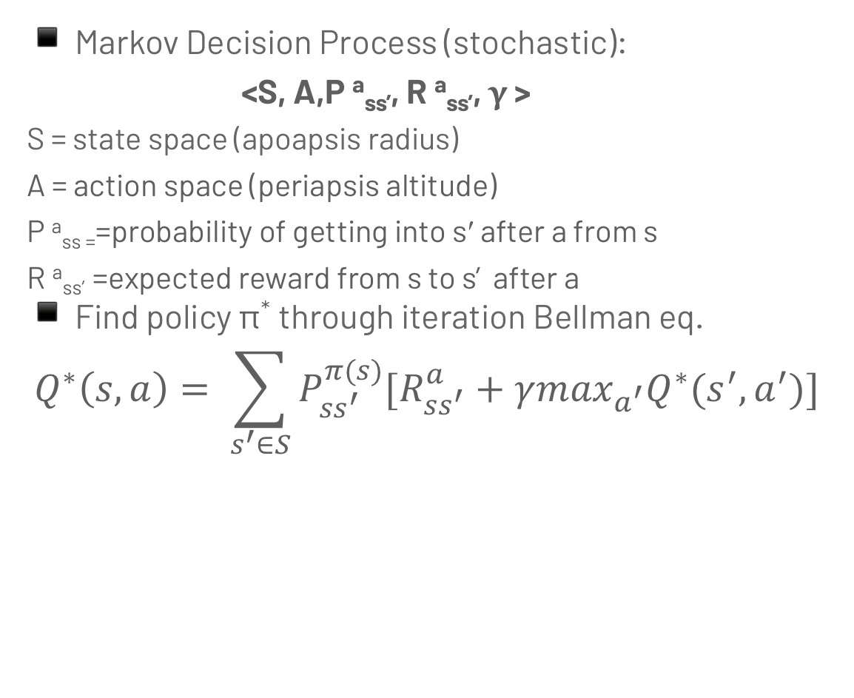
REINFORCEMENT LEARNING
Markov Decision Process (stochastic):
<S, A,P ª_{ss’}, R ª_{ss’}, γ >
S = state space (apoapsis radius)
A = action space (periapsis altitude)
P ª_{ss =}=probability of getting into s′ after a from s
R ª_{ss’} =expected reward from s to s’ after a
Find policy π* through iteration Bellman eq.
$$Q^{∗}\left(s,a\right)= \sum_{s^{′}∈S}{P_{ss^{′}}^{π(s)}[R_{ss^{′}}^{a}}+γ\max_{a^{′}}Q^{∗}(s^{′},a^{′})]$$

Slide 19
MDP
STATE SPACE
Apoapsis radius
From 4000 to 400000 km.
981 states.
ACTION SPACE
Periapsis altitude
From 105 to 127 km.
147 states.
REWARD FUNCTION
Reward:
Reach goal.
If closer to corridor boundary (dynamic).
Penalty:
Overcome heat rate (0.4 W/cm²), dynamic pressure (0.4 N/m^2).
Escape/Impact.
If apoapsis radius does not variate.

Slide 20
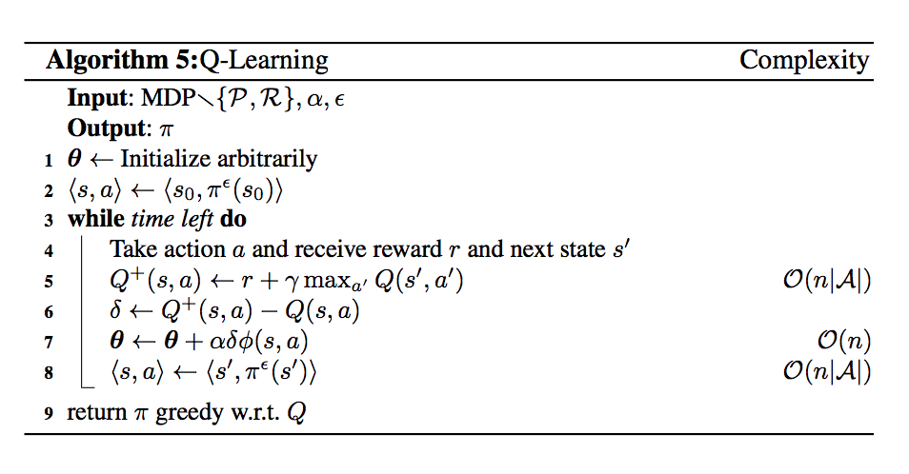
Q-LEARNING ALGORITHM
Off-policy and model free algorithm

Slide 21
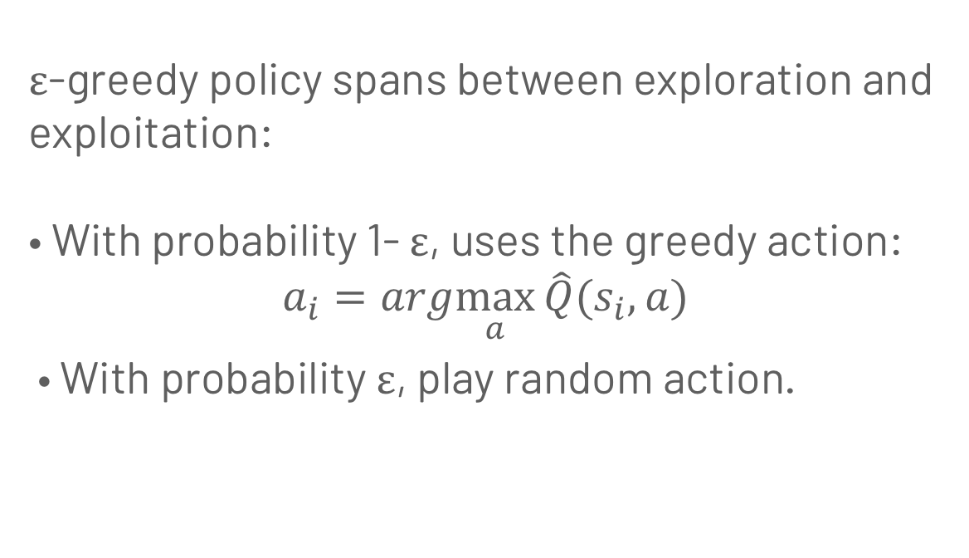
ε-GREEDY POLICY SEARCH
ε-greedy policy spans between exploration and exploitation:
• With probability 1- ε, uses the greedy action:
$$a_{i}=arg\max_{a}{\hat{Q}(s_{i},a)}$$
• With probability ε, play random action.

